Slide 1
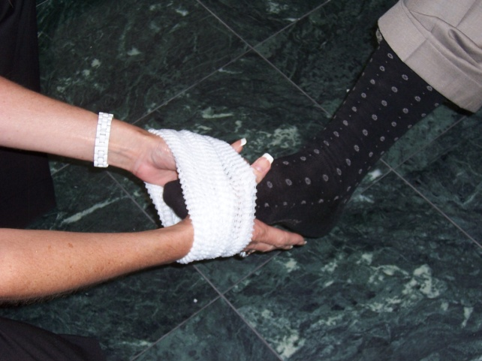
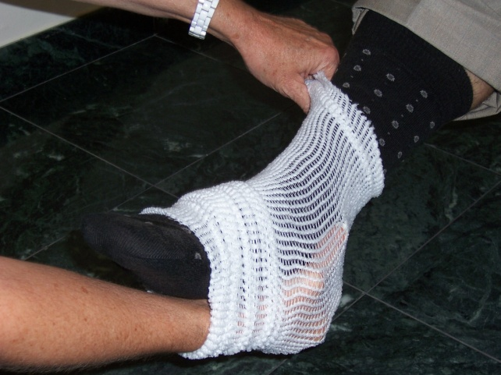
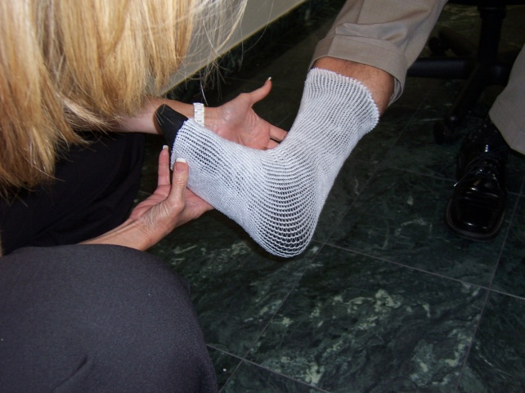
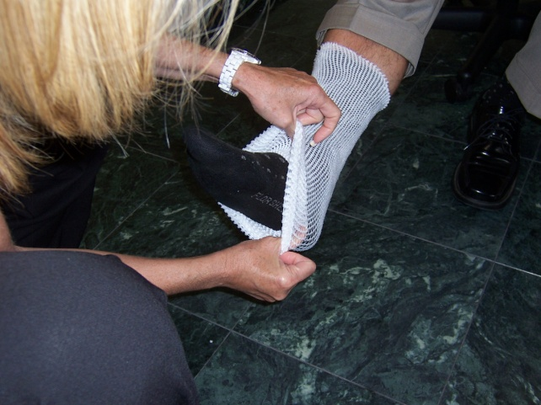
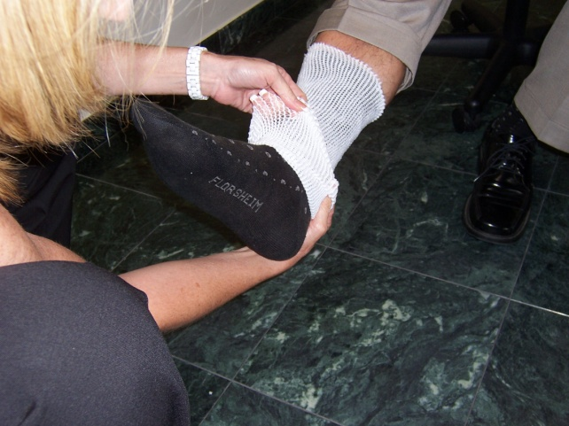
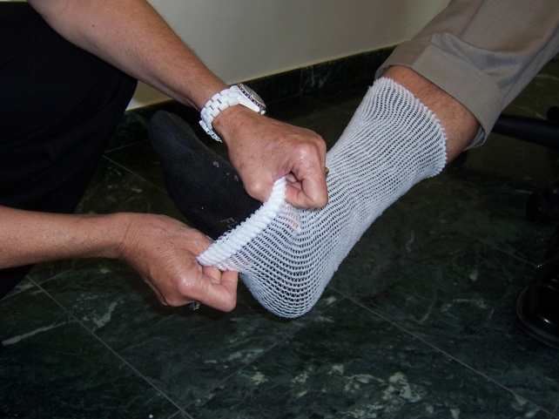
How to Apply Spandage: Foot
1
2
3
Start with an approximate 18” length of
Spandage. Use your hands as an
applicator.
Work Spandage up the foot. Secure
The top with one hand, and continue
stretching over the foot.
Foot application completed view.
always leave enough Spandage
above the ankle so it is anchored.
5
6
4
Dressing changes are easily done by simply rolling Spandage back over the dressing,
changing the dressing & pulling Spandage back over the foot!

